Slide 1
ML Training
Week 1: Data Prep recap
Iliyan Gochev
Software Consultant

Slide 2

Having a template
Notes:
Добре е да имате някакъв шаблон за целия процес на работа, но не винаги това ще ви доведе до оптималните резултати.
Наистина при data prep частта един такъв шаблон би бил много полезен, но следващите части от процеса: feature building, modeling & evaluation е по-добре да не са вкарани в калъпа / тръбата / кутията. Те представляват много повече креативен процес, при който ако използвате шаблон, може да пропуснете нещо важно или да не помислите от друга гледна точка.

Slide 3
The libraries
Notes:
Нямам забележка, Pandas и Numpy са най-важните библиотеки от гледна точка на манипулирането на данни. Всички аналитични фреймуърци знаят как да конвертират към техните си вътрешни формати.
За графиките вече избора е голям и може да зависи от проекта или човека: Matplotlib, Seaborn (SNS), Plotly, Bokeh…

Slide 4

Importing Data
Notes:
Pandas има pd.read_ семейство от функции, които могат да ви помогнат с бързото извличане на данни както от CSV файлове, така и от бази данни, SAS, SPSS, Excel, Parquet, HDF, питонския pickle формат и доста други.

Slide 5
Pd.read_csv(‘filename’)
Notes:
The only thing you need to enter here is the filename….
При работата с реални (големи) обеми от данни ще ви се наложи да използвате и други от опционалните аргументи на Read_* семейството от функции.
https://pandas.pydata.org/pandas-docs/stable/reference/api/pandas.read_csv.html
sep – separator (Специфично за CSV)
Тези два параметъра са много подходящи, когато се анализират големи обеми от данни:
Nrows – избира N-броя редове от файла
usecols – зареждане само определени колони в паметта
low_memory – не се използва имплементация, която зарежда данните на чънкове. Понякога при голям обем от данни зареждането на чънкове може погрешно да определи типовете данни. Алтернатива е да се подаде „схема на данните“ с dtype.

Slide 6
The Target variable always comes last in a dataset
Notes:
Живеем в свят, който не е перфектен, няма как и данните ни да са перфектни. Освен ако някой друг не се грижи за формата на данните преди да ви ги дадат за анализ и обучение, вероятността да имате зависими променливи на различно от „последната колона в таблицата“ е голяма.
От личен опит, обикновено е някъде по средата насред всички други независими променливи.

Slide 7
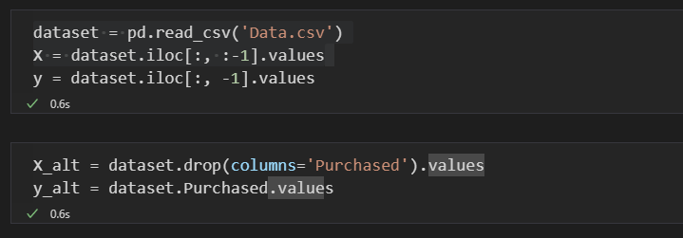
Splitting Features / Labels
Notes:
Алтернатива за създаването на

Slide 8
Missing Data, MD
Notes:
Как да се справяме с липсващите данни.
В курса не е добре обяснено различните видове възможности за справяне с проблема с липсващите данни.

Slide 9
Missing Data Imputation
Part of data pre-processing:
Can make or break a model
Necessity depends on the model specificity
Techniques:
Go back to the source and verify they are actually missing
Ignoring records with missing values
Manual imputation
Using a global constant
Using the mean/mode
Using “nearest” objects
Using a model to predict the missing values
Highlighted methods change data distribution and do not consider possible correlation/association between attributes
Notes:
Some models can work directly with missing data, but this would not be useful
Z-нормализация и мини-максна нормализация са споменати в курса
Encoding = бинаризaция

Slide 10
Encoding
Notes:
Отново темата е доста повърхностно засегната и е представен само OHE. Дължи се най-вече на липсата на обяснение за типовете данни (по-надолу в презентацията)

Slide 11
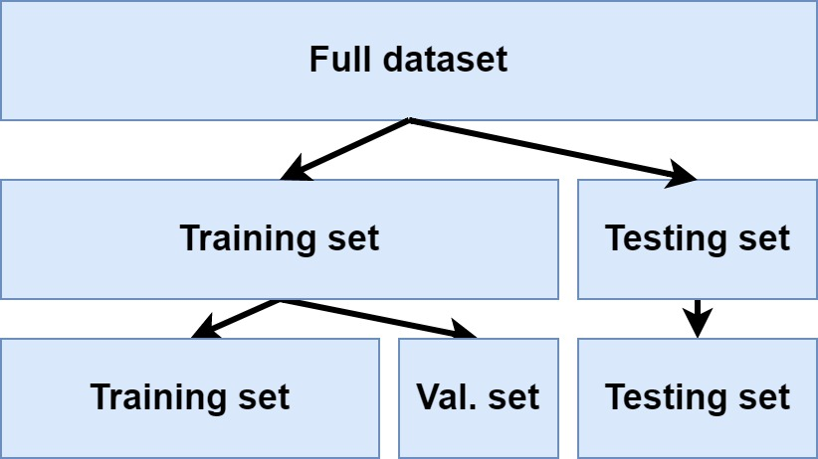
Train and test split
Notes:
Information Leakage,
Transformations of predictor variables may be needed for several reasons.
Some modeling techniques may have strict requirements, such as the predictors
having a common scale. In other cases, creating a good model may be
difficult due to specific characteristics of the data (e.g., outliers).
Why it’s important
Train vs validation vs test
Scaling after split
N.B. Adding random state

Slide 12
They didn’t tell you about it

Slide 13
The Process

Slide 14
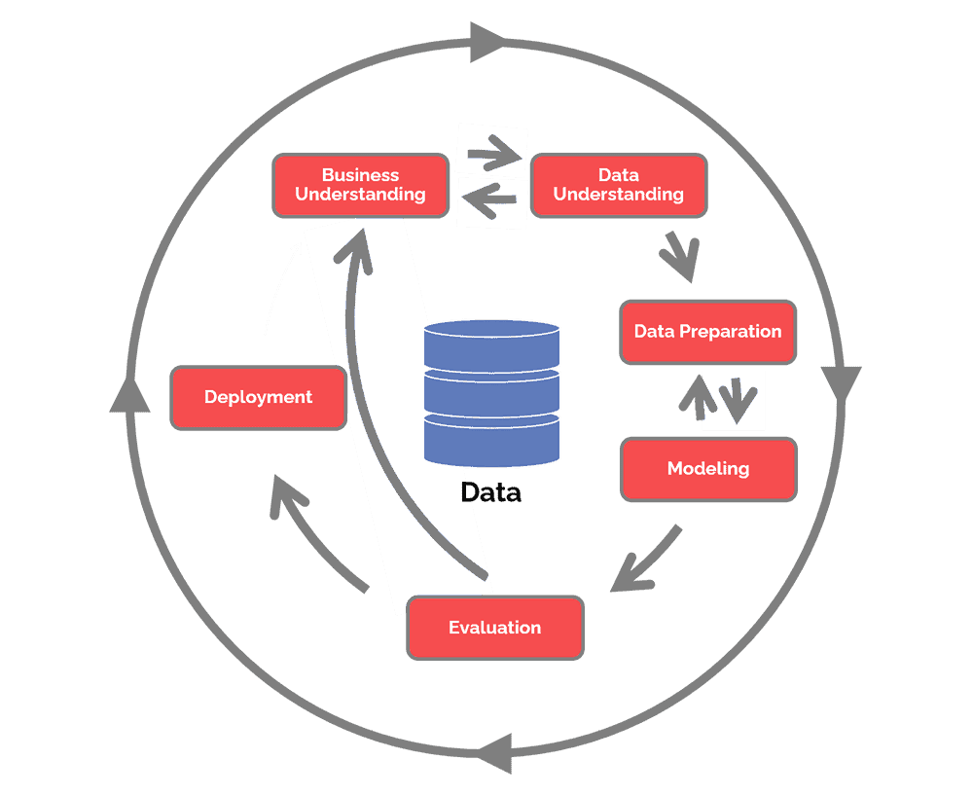
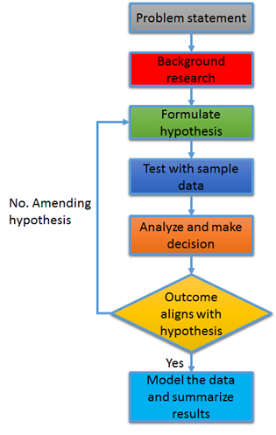
Notes:
Cross-industry standard process for data mining starts in 1997 as a process, defined by large organizations with know-how in the field of data analytics and extracting knowledge from data.
As you can see it does not differ from what is considered a “Data Scientist workflow”.
In this training we will try to follow the CRISP-DM methodology as close as possible, as it has proven to be a solid foundation for doing not only Data Mining, but general Machine Learning / Data Science.

Slide 15
The DATA

Slide 16
Types of Data
Notes:
Numerical, Categorical (and Ordinal)

Slide 17
Numerical data
Notes:
These data have meaning as a measurement, such as a person’s height, weight, IQ, or blood pressure; or they’re a count, such as the number of stock shares a person owns, how many teeth a dog has, or how many pages you can read of your favorite book before you fall asleep. (Statisticians also call numerical data quantitative data.)
Numerical data can be further broken into two types: discrete and continuous.
Discrete data represent items that can be counted; they take on possible values that can be listed out. The list of possible values may be fixed (also called finite); or it may go from 0, 1, 2, on to infinity (making it countably infinite).For example, the number of heads in 100 coin flips takes on values from 0 through 100 (finite case), but the number of flips needed to get 100 heads takes on values from 100 (the fastest scenario) on up to infinity (if you never get to that 100th heads). Its possible values are listed as 100, 101, 102, 103 . . . (representing the countably infinite case).
Continuous data represent measurements; their possible values cannot be counted and can only be described using intervals on the real number line. For example, the exact amount of gas purchased at the pump for cars with 20-gallon tanks would be continuous data from 0 gallons to 20 gallons, represented by the interval [0, 20], inclusive. You might pump 8.40 gallons, or 8.41, or 8.414863 gallons, or any possible number from 0 to 20. In this way, continuous data can be thought of as being uncountably infinite. For ease of recordkeeping, statisticians usually pick some point in the number to round off. Another example would be that the lifetime of a C battery can be anywhere from 0 hours to an infinite number of hours (if it lasts forever), technically, with all possible values in between. Granted, you don’t expect a battery to last more than a few hundred hours, but no one can put a cap on how long it can go (remember the Energizer Bunny?).

Slide 18
Categorical data
Notes:
Categorical data represent characteristics such as a person’s gender, marital status, hometown, or the types of movies they like. Categorical data can take on numerical values (such as “1” indicating male and “2” indicating female), but those numbers don’t have mathematical meaning. You couldn’t add them together, for example. (Other names for categorical data are qualitative data, or Yes/No data.)
Examples:
The roll of a six-sided die: possible outcomes are 1,2,3,4,5, or 6.
Demographic information of a population: gender, disease status.
The blood type of a person: A, B, AB or O.
The political party that a voter might vote for, e. g. Green Party, Christian Democrat, Social Democrat, etc.
The type of a rock: igneous, sedimentary or metamorphic.
The identity of a particular word (e.g., in a language model): One of V possible choices, for a vocabulary of size V.

Slide 19
Ordinal data
Notes:
Ordinal data
Ordinal data mixes numerical and categorical data. The data fall into categories, but the numbers placed on the categories have meaning. For example, rating a restaurant on a scale from 0 (lowest) to 4 (highest) stars gives ordinal data.
Ordinal data are often treated as categorical, where the groups are ordered when graphs and charts are made. However, unlike categorical data, the numbers do have mathematical meaning. For example, if you survey 100 people and ask them to rate a restaurant on a scale from 0 to 4, taking the average of the 100 responses will have meaning. This would not be the case with categorical data.

Slide 20
Why should I care?
Notes:
Различните типове данни се интерпретират и третират по различен начин, имат различни разпределения и ни дават различна информация.
Трябва да познаваме основните свойства на данните, за да знаем какви алгоритми за машинно самообучение да ползваме.
Един от основните примери е кодирането на категорийни променливи. Трябва да знаем дали има някаква връзка между различните стойности на категорията или не за да приложим правилният Encoder.
Например между дните в седмицата имаме стриктна зависимост, докато между два цвята (в общия случай) не.

Slide 21
TaskS

Slide 22
How to improve on our Data Prep template
Notes:
Read about following pandas methods and properties and try to improve your data pre-processing template:
head
columns
describe
dtypes
corr
Hist
Look at the cheat sheet for more ideas.

Slide 23
GitHub - guipsamora/pandas_exercises: Practice your pandas skills!

Slide 24
Homework assignment
You are given the first dataset: bank-additional-full.csv
This is a dataset, describing Portugal bank marketing campaigns results. Conducted campaigns were based mostly on direct phone calls, offering the clients to place a term deposit. If a client has agreed to place deposit, the target variable is marked “yes”, otherwise “no”. The second dataset contains product listings as well as products ratings and sales performance: summer-products-with-rating-and-performance_2020-08.csv. The data was scraped in the French locale (hence some non-ascii latin characters such as « é » and « à ») in the title column. The title_orig on the other hand contains the original title (the base title) that is displayed by default. When a translation is provided by the seller, it appears in the title column. When the title and title_orig columns are the same, it generally means that the seller did not specify a translation that would be displayed to users with French settings.
Your first task would be to fully understand the data and present some form of description of what you have found, be it a short presentation or text or simply present it with your teammate in the next meeting. Bellow you will find questions to guide you in this preliminary analysis, but feel free to be creative and try whatever you feel might be interesting.
For the marketing campaign dataset:
At first glance, are the marketing campaigns successful? Is one type of contact more successful than the other?
What is the profile of the available customers? Are responsive customers characterized with some specific qualities compared to unresponsive ones?
How much do customers engage with the campaigns? Does it affect the result?
For the e-commerce dataset:
Which products sell well and how well? Which do not?
Which are the top merchants? What differentiates them from the rest?
Is rating a significant factor when it comes to sales? How about the price drop?

Slide 25
Next Time
Notes:
Part 2: Regression: Section 6: Simple Linear Regression, Section 7: Multiple Linear Regression, Section 8: Polynomial Regression

Slide 26
Thank you!

